Slide 1
Big Data Analysis & Prediction of U.S. Airline Flight Delays
Pranav Pareshkumar Barot Sailesh Pulukuri

Slide 2
Problem Statement
Objective: Understand how different factors — such as airline, airport type (hub/non-hub), route, month, and time of day — impact flight delays across the U.S.
Research Questions:
Which airlines experience the longest delays?
How do hub airports compare with non-hubs in performance?
What are the major causes of delay (Airline, NAS, Weather)?
How do individual flight delays propagate through the network?
Dataset: U.S. Department of Transportation (DOT) Flight On-Time Performance Data (2015; scalable for newer years).

Slide 3
Dataset Summary & Understanding
Source: U.S. DOT On-Time Flight Performance Dataset Years: 1995 – 2015 Total Records: ~30+ million flights Size: ~50 GB
Key attributes:
Airline, Origin, Destination
Distance, Scheduled/Actual Times
Delay components: NAS, Weather, Carrier, Late Aircraft, Security
Date/time fields

Slide 4
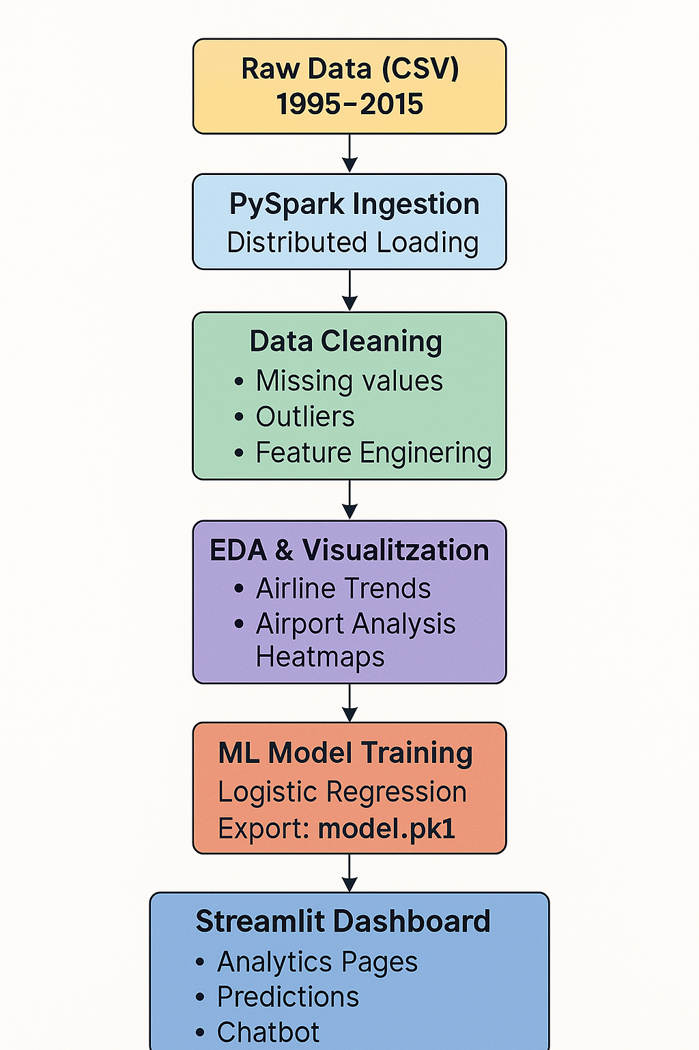
Project Architecture (Big-Data Pipeline)
1. Data Ingestion
Loaded raw CSVs (multi-GB) using PySpark
Distributed reading to avoid memory crash
2. Data Cleaning
Removed nulls, invalid airport codes
Handled negative delay values
Feature engineering (TOTAL_DELAY, Hub Indicator, Route Field)
3. EDA & Visualization
Used PySpark + Pandas sample
Generated airline, airport, route, time-based trends
4. Machine Learning
Trained multiple models
Exported best model → model.pkl
5. Interactive Dashboard
Built with Streamlit
Pages: Airline, Airport, Routes, Time Trends, Relationships
Chatbot + Prediction interface

Slide 5
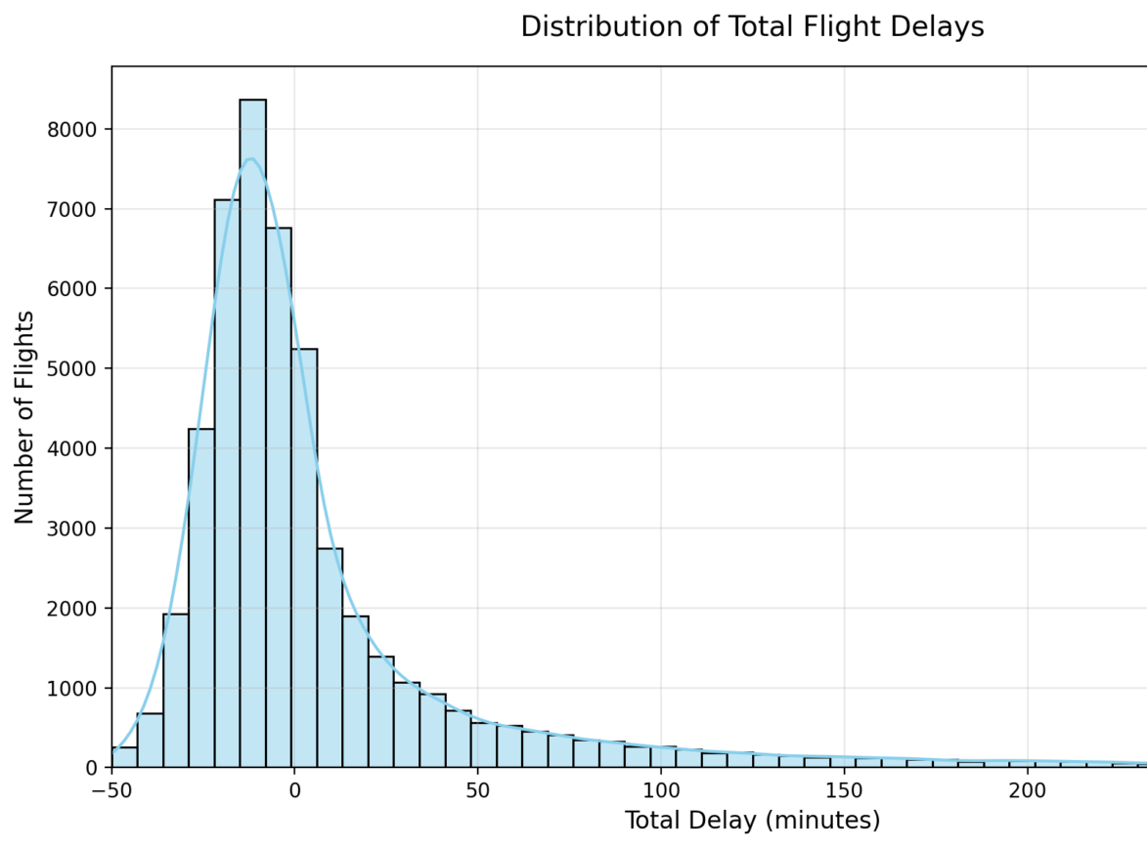
Delay Distribution Overview
Majority of flights have minor delays.
Delay pattern is right-skewed, with few extreme delays.
Severe delays (>100 min) are uncommon but impactful.
Helps identify outlier behavior for prediction models.

Slide 6
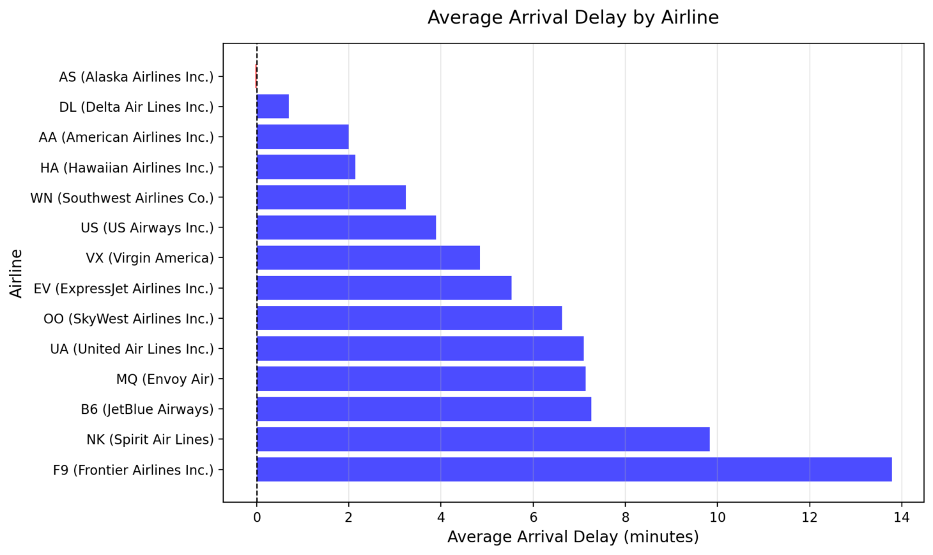
Airline Delay Analysis
Average Arrival Delay by Airline
Airlines like Alaska, Delta perform highly reliably
Frontier & Spirit show highest average delays

Slide 7
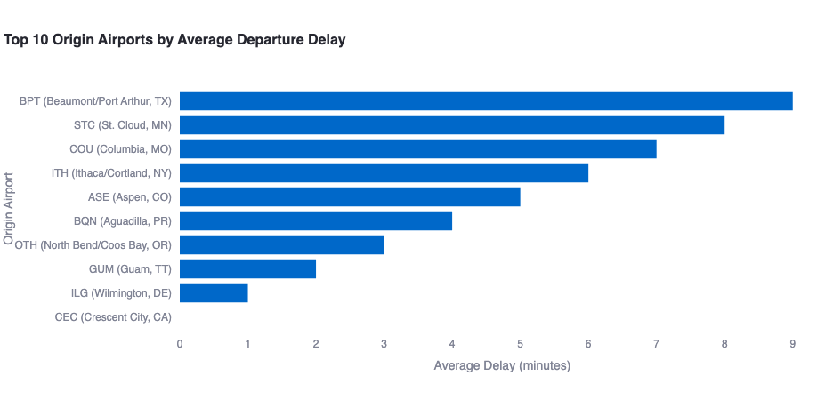
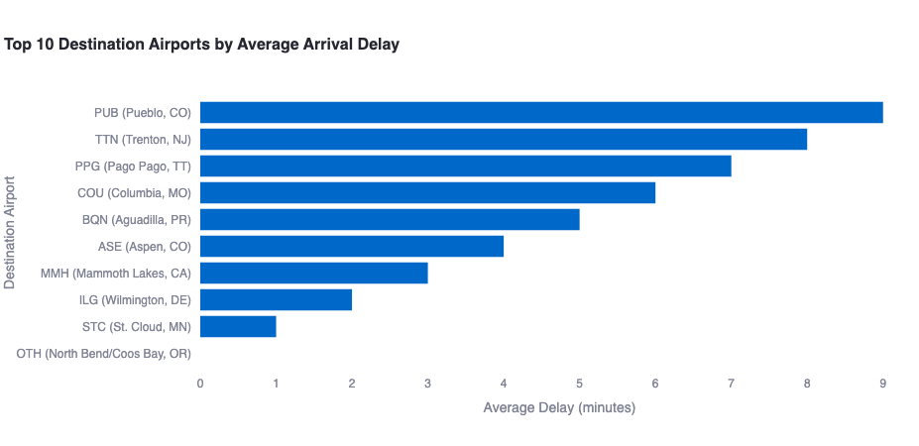
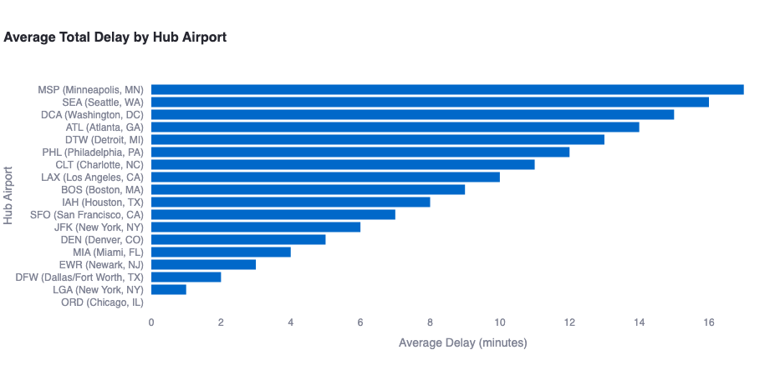
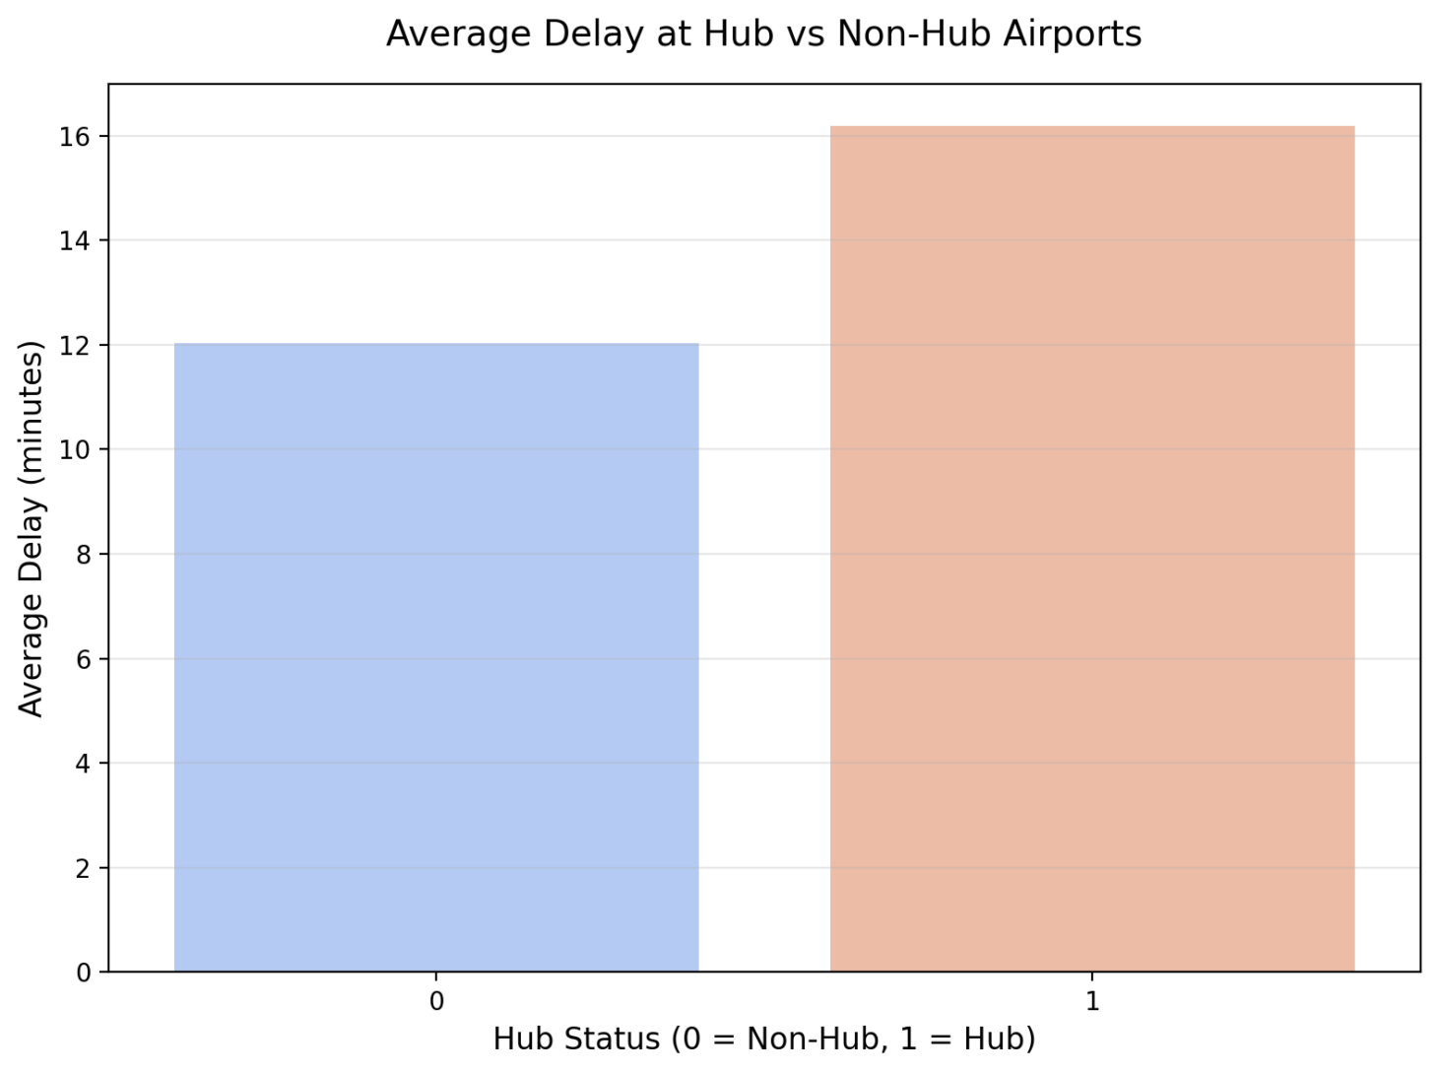
Airport Delay Analysis

Slide 8
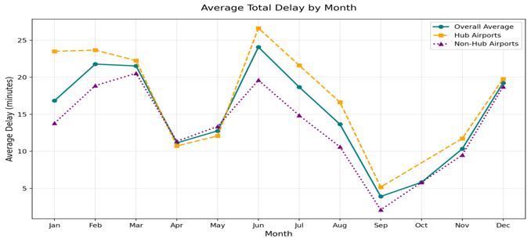
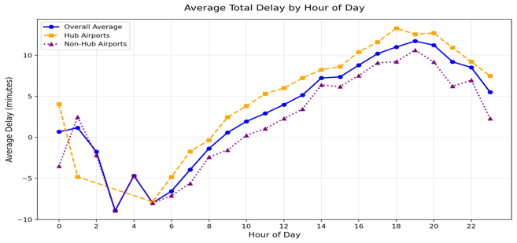
Time-Based Delay Trends
Hourly Delay Trend → Low in mornings, spike in evenings (7–9 PM).
Monthly Trend: Delay spikes in Feb–Mar & June; lowest in Apr and Sept–Oct due to favorable weather and lower congestion.

Slide 9
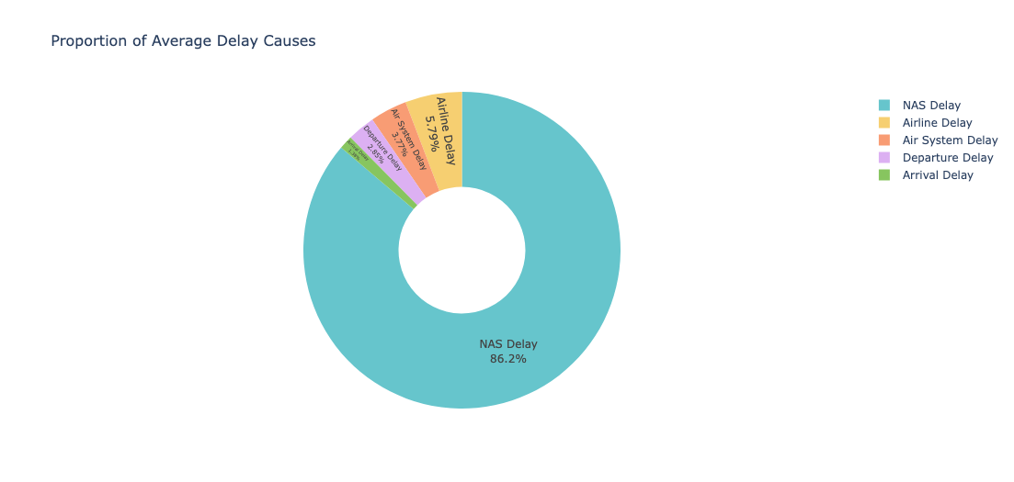
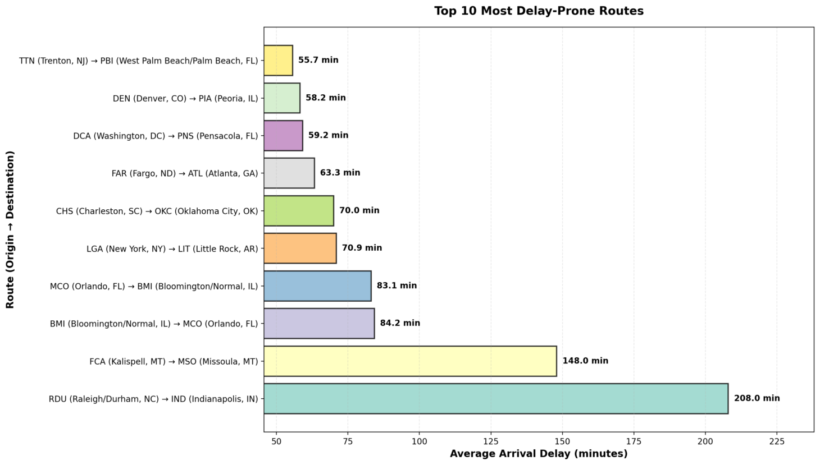
Route Delays & Major Delay Causes
NAS system delays dominate (~85–90%), showing that delays are largely due to airspace congestion and weather.
Airline-related delays form the next major category (~7%).
Most delay-prone routes include TTN→PBI, DEN→PIA, DCA→PNS, and several long-distance regional routes.

Slide 10
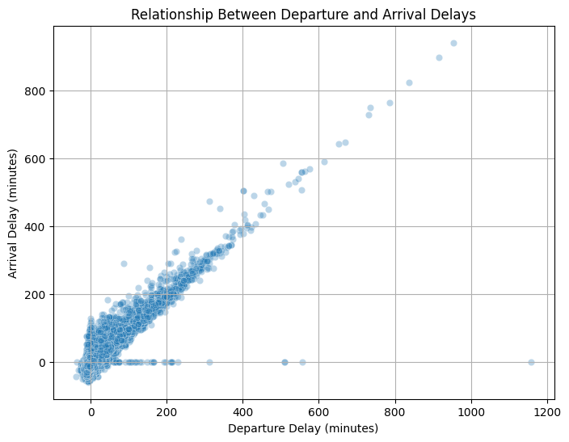
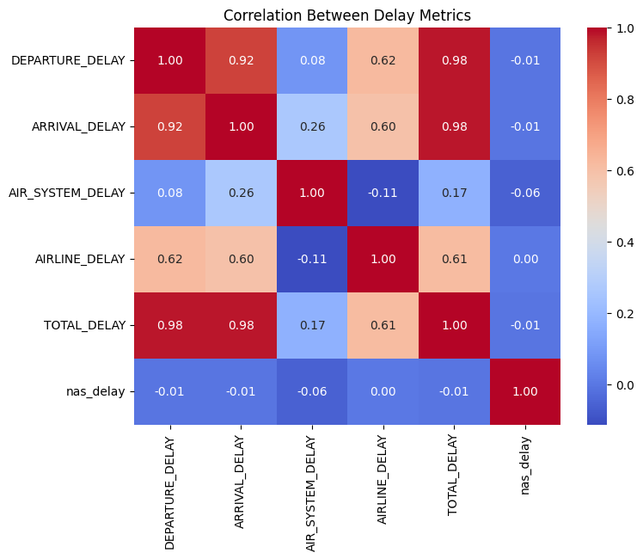
Individual Flight Delay Analysis
Departure → Arrival Delay Propagation
Strong linear relationship: late departures almost always lead to late arrivals.
Scatter plot confirms consistent propagation across all delay scales.
Correlation Heatmap Insights
Highest correlation: Departure Delay Arrival Delay (r ≈ 0.88)
Total delay influenced heavily by NAS delays and late-arriving aircraft.
Multiple delay types interact, but departure timing is the strongest driver.

Slide 11
Key Findings
Insight | Description
Major Cause | NAS (Air Traffic System) delays are the dominant contributor (~85–90%).
Airline Performance | Alaska & Delta are most punctual; Frontier & Spirit show highest delays.
Airport Impact | Hub airports show slightly higher delays due to traffic congestion.
Daily Pattern | Delays accumulate through the day, with peak delays in the evening (7–9 PM).
Monthly Pattern | Delay spikes in Feb–Mar & June; lowest delays in Apr and Sept–Oct.
Route Impact | Certain long-distance regional routes (e.g., TTN→PBI, DEN→PIA) experience longest delays.
Delay Propagation | Strong correlation between departure & arrival delay (r ≈ 0.88) — late departures almost always lead to late arrivals.
Delay Distribution | Delay times are right-skewed — most flights have small delays; extreme delays (>100 min) are rare but impactful.

Slide 12
Machine Learning Model & Performance Metrics
Models Evaluated
We tested four supervised ML models to predict whether a flight will be delayed (>15 minutes):
Logistic Regression (LR)
Decision Tree (DT)
Random Forest (RF)
Gradient Boosted Trees (GBT)
Feature Set Used
Categorical (encoded): Airline, Origin Airport, Destination Airport
Numerical: Month, Day of Week, Departure Delay, Distance
Target: Delayed vs Not Delayed (binary classification)

Slide 13
Model Performance Comparison
Model | AUC Score | Observation
Logistic Regression | 0.9100 | Best model – highest predictive power
Decision Tree | 0.5815 | Weak model; high variance
Random Forest | 0.8871 | Good generalization; stable
Gradient Boosted Trees | 0.8901 | Performs well; strong baseline

Slide 14
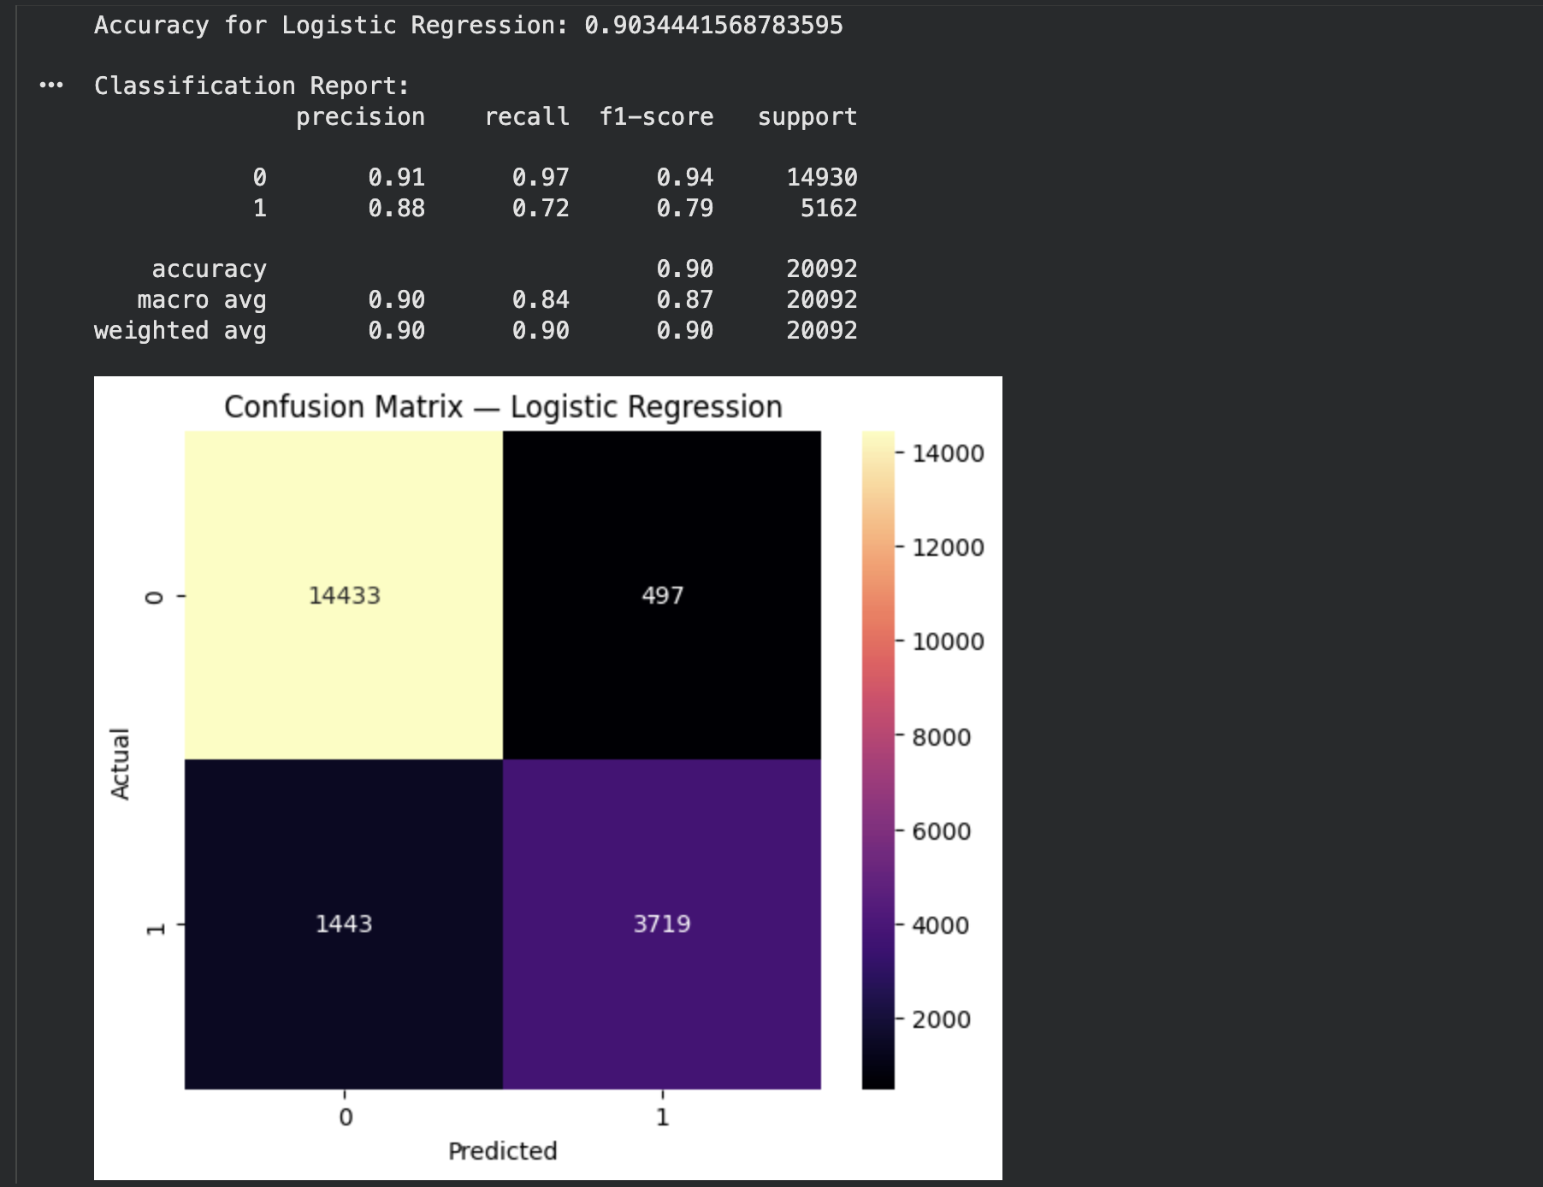
Logistic Regression – Model Evaluation
Model Accuracy
Accuracy: 0.9034
The model correctly predicts delay vs non-delay ~90% of the time.
Precision & Recall
Precision (Delayed – Class 1): 0.88
Recall (Delayed – Class 1): 0.72
Excellent at identifying on-time flights (Class 0 recall = 0.97).
More conservative in predicting delays → fewer false alarms.
F1-Scores
F1 (On-time – Class 0): 0.94
F1 (Delayed – Class 1): 0.79
Strong overall balance, especially on the majority class.
Interpretation
Logistic Regression delivers high accuracy, high precision, and interpretability.
Very low false positives → fewer unnecessary operational alerts.
Reliable baseline model for large-scale flight delay prediction.

Slide 15
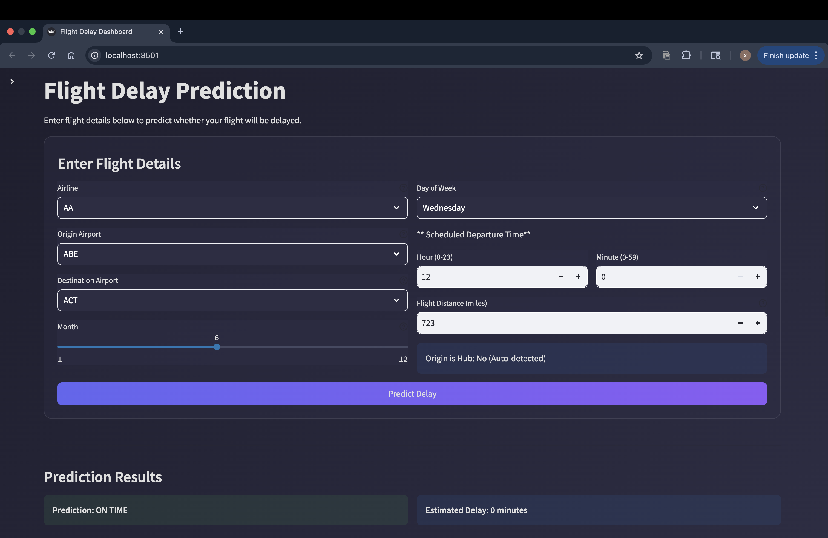
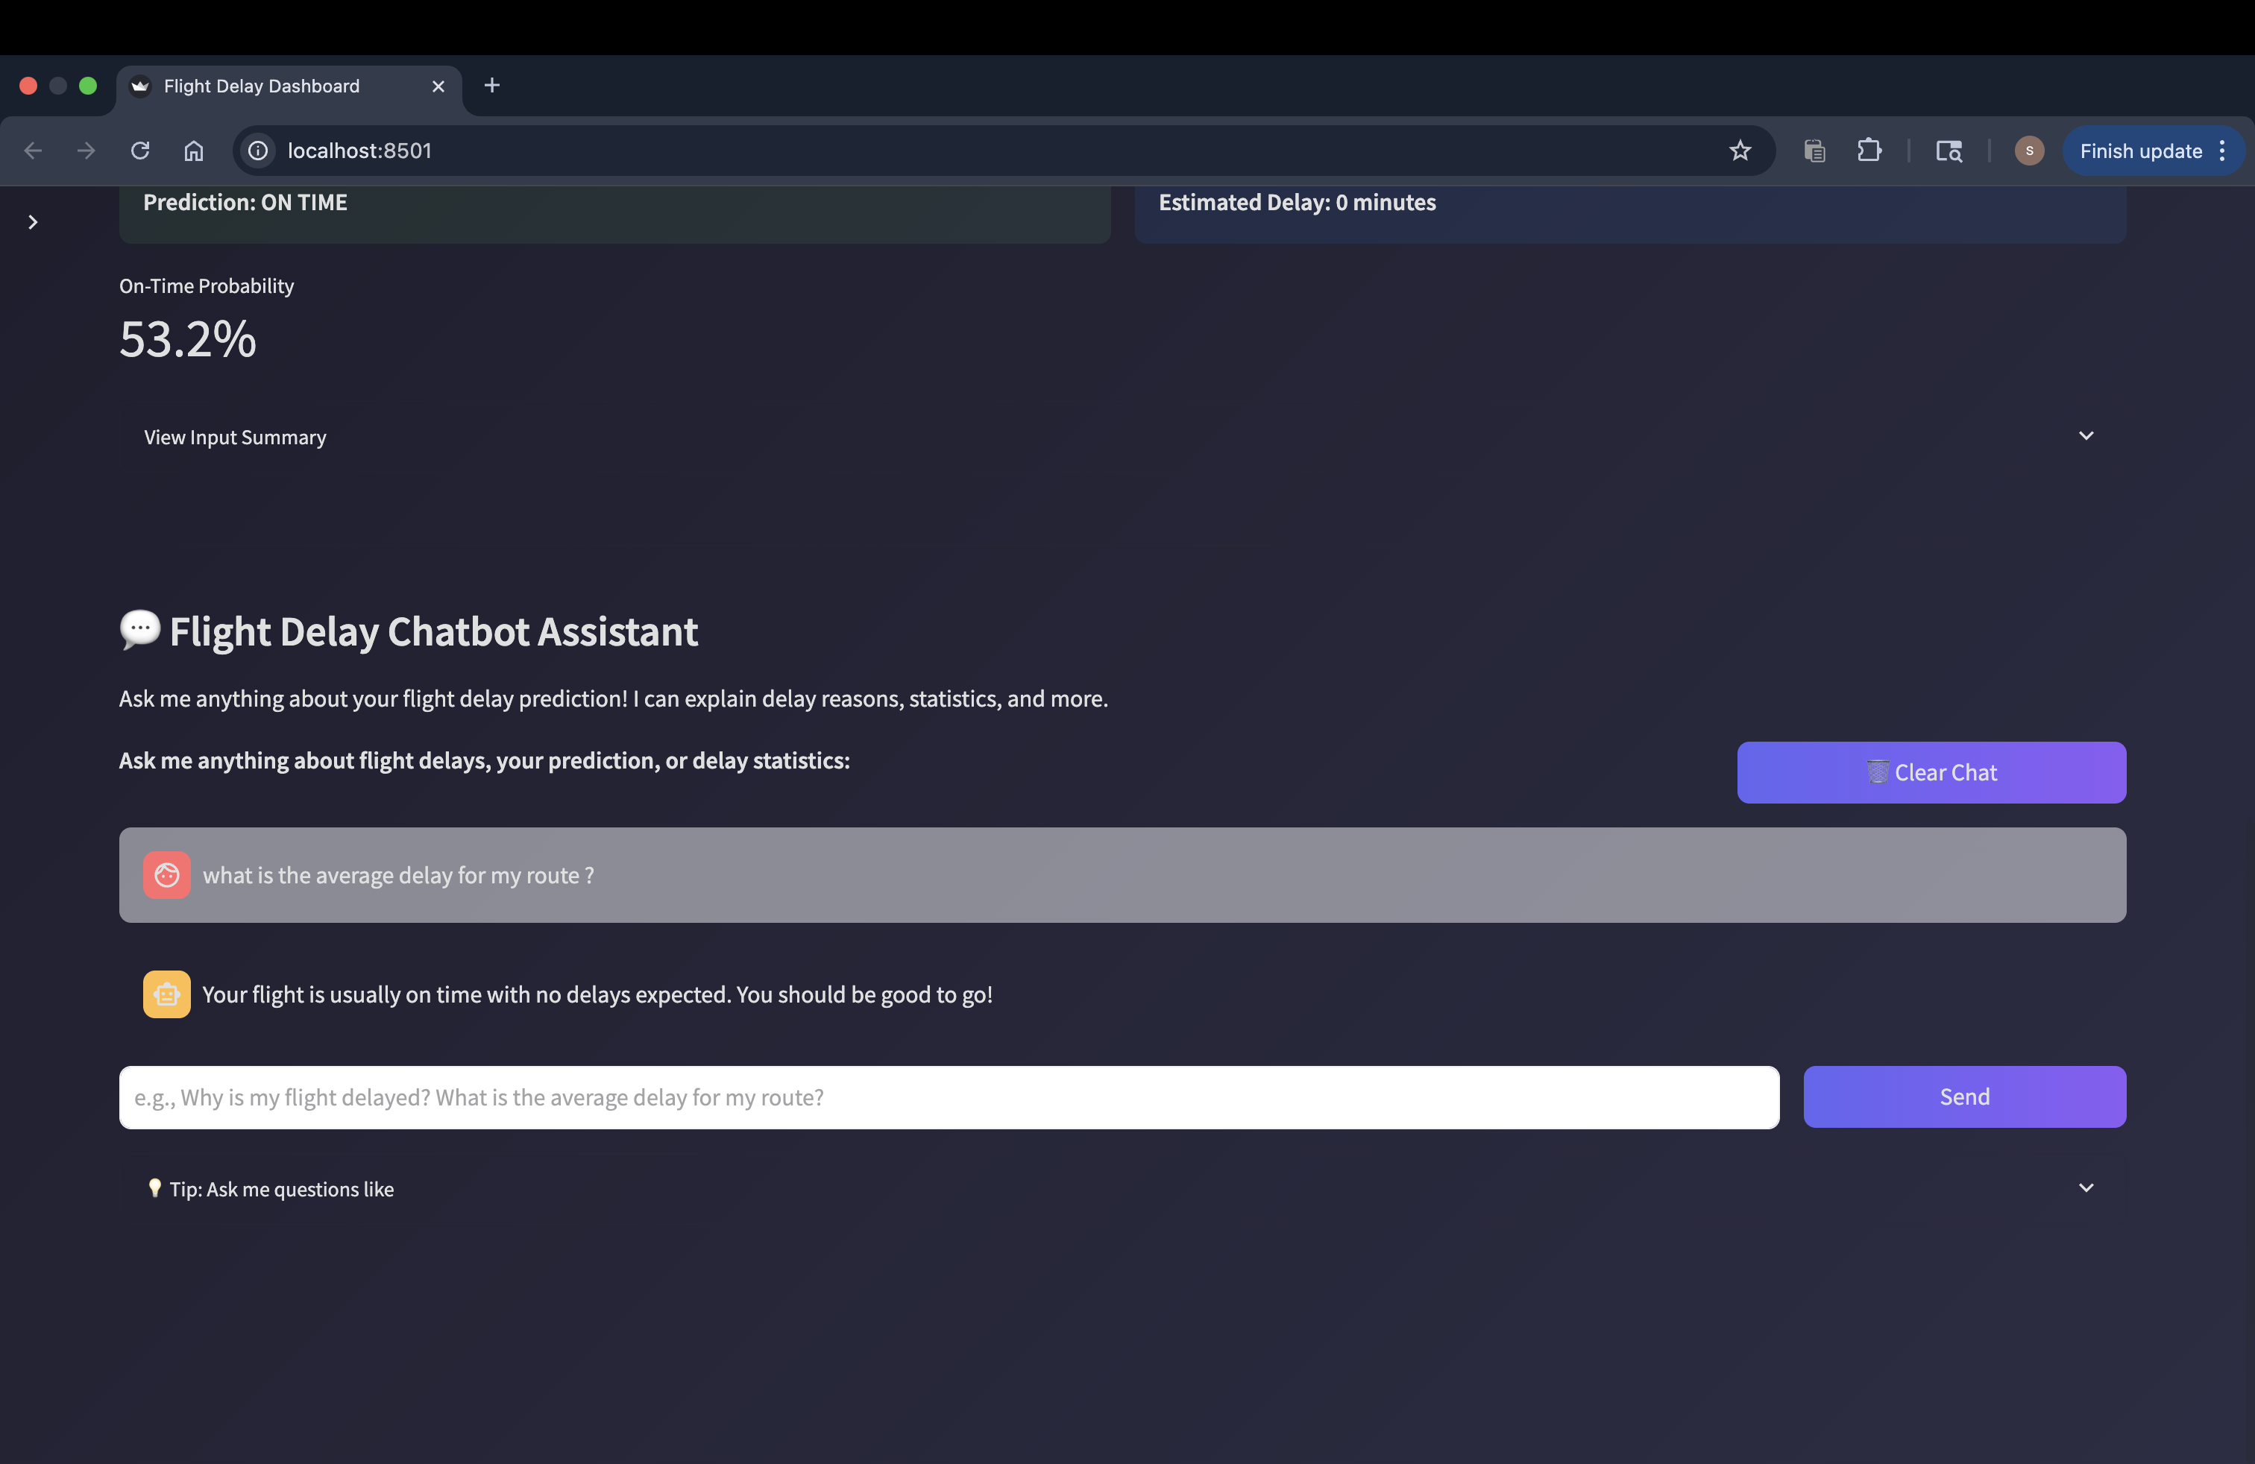
Model Deployment – Prediction UI & Chatbot Integration
Flight Delay Prediction Interface
Users enter key flight details.
Logistic Regression model predicts delay probability.
Simple UI with clear results for quick decision-making.
Chatbot Assistant
Explains predictions in plain language.
Answers questions about delay reasons and airport effects.
Makes the dashboard more interactive and user-friendly.

Slide 16
Conclusion
This project successfully built a big-data pipeline for processing 20 years of U.S. flight records (1995–2015).
Insights revealed key delay patterns involving airlines, airports, routes, and time-based trends.
Logistic Regression delivered strong predictive performance (~90% accuracy), making it suitable for real-time delay prediction.
The interactive Streamlit dashboard + chatbot assistant enables users to explore insights and receive explainable predictions.
This solution demonstrates how data engineering + machine learning can support operational decision-making in aviation.

Slide 17
Thank you

